Slide 1
Jermyn Borough Council Meeting
12/19/19

Slide 2
Meeting Agenda
Call to Order
Pledge of Allegiance
Roll Call
Previous Meeting Minutes
Treasurer’s Report/Bills Payable
Correspondence
Public Comment
Official Reports
Reports of Committees
Feral Cats
Borough Flag
2020 Budget
2020 Tax Ordinance
Lackawanna County Floodplain Maps and Ordinance Update
Garbage Ordinance
Fee Resolution
Executive Session – Personnel
New Business
Adjournment

Slide 4

DESIGN THE JERMYN BOROUGH FLAG
CONTEST

Slide 5
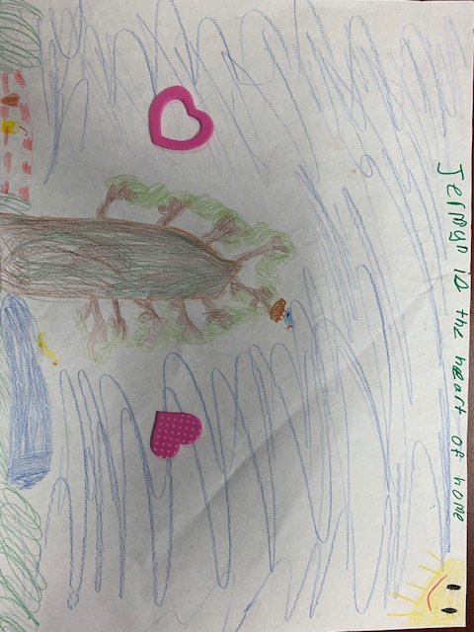
Bella Battenberg
submission

Slide 6

Cody stang submission 1

Slide 7

Cody stang submission 2

Slide 8
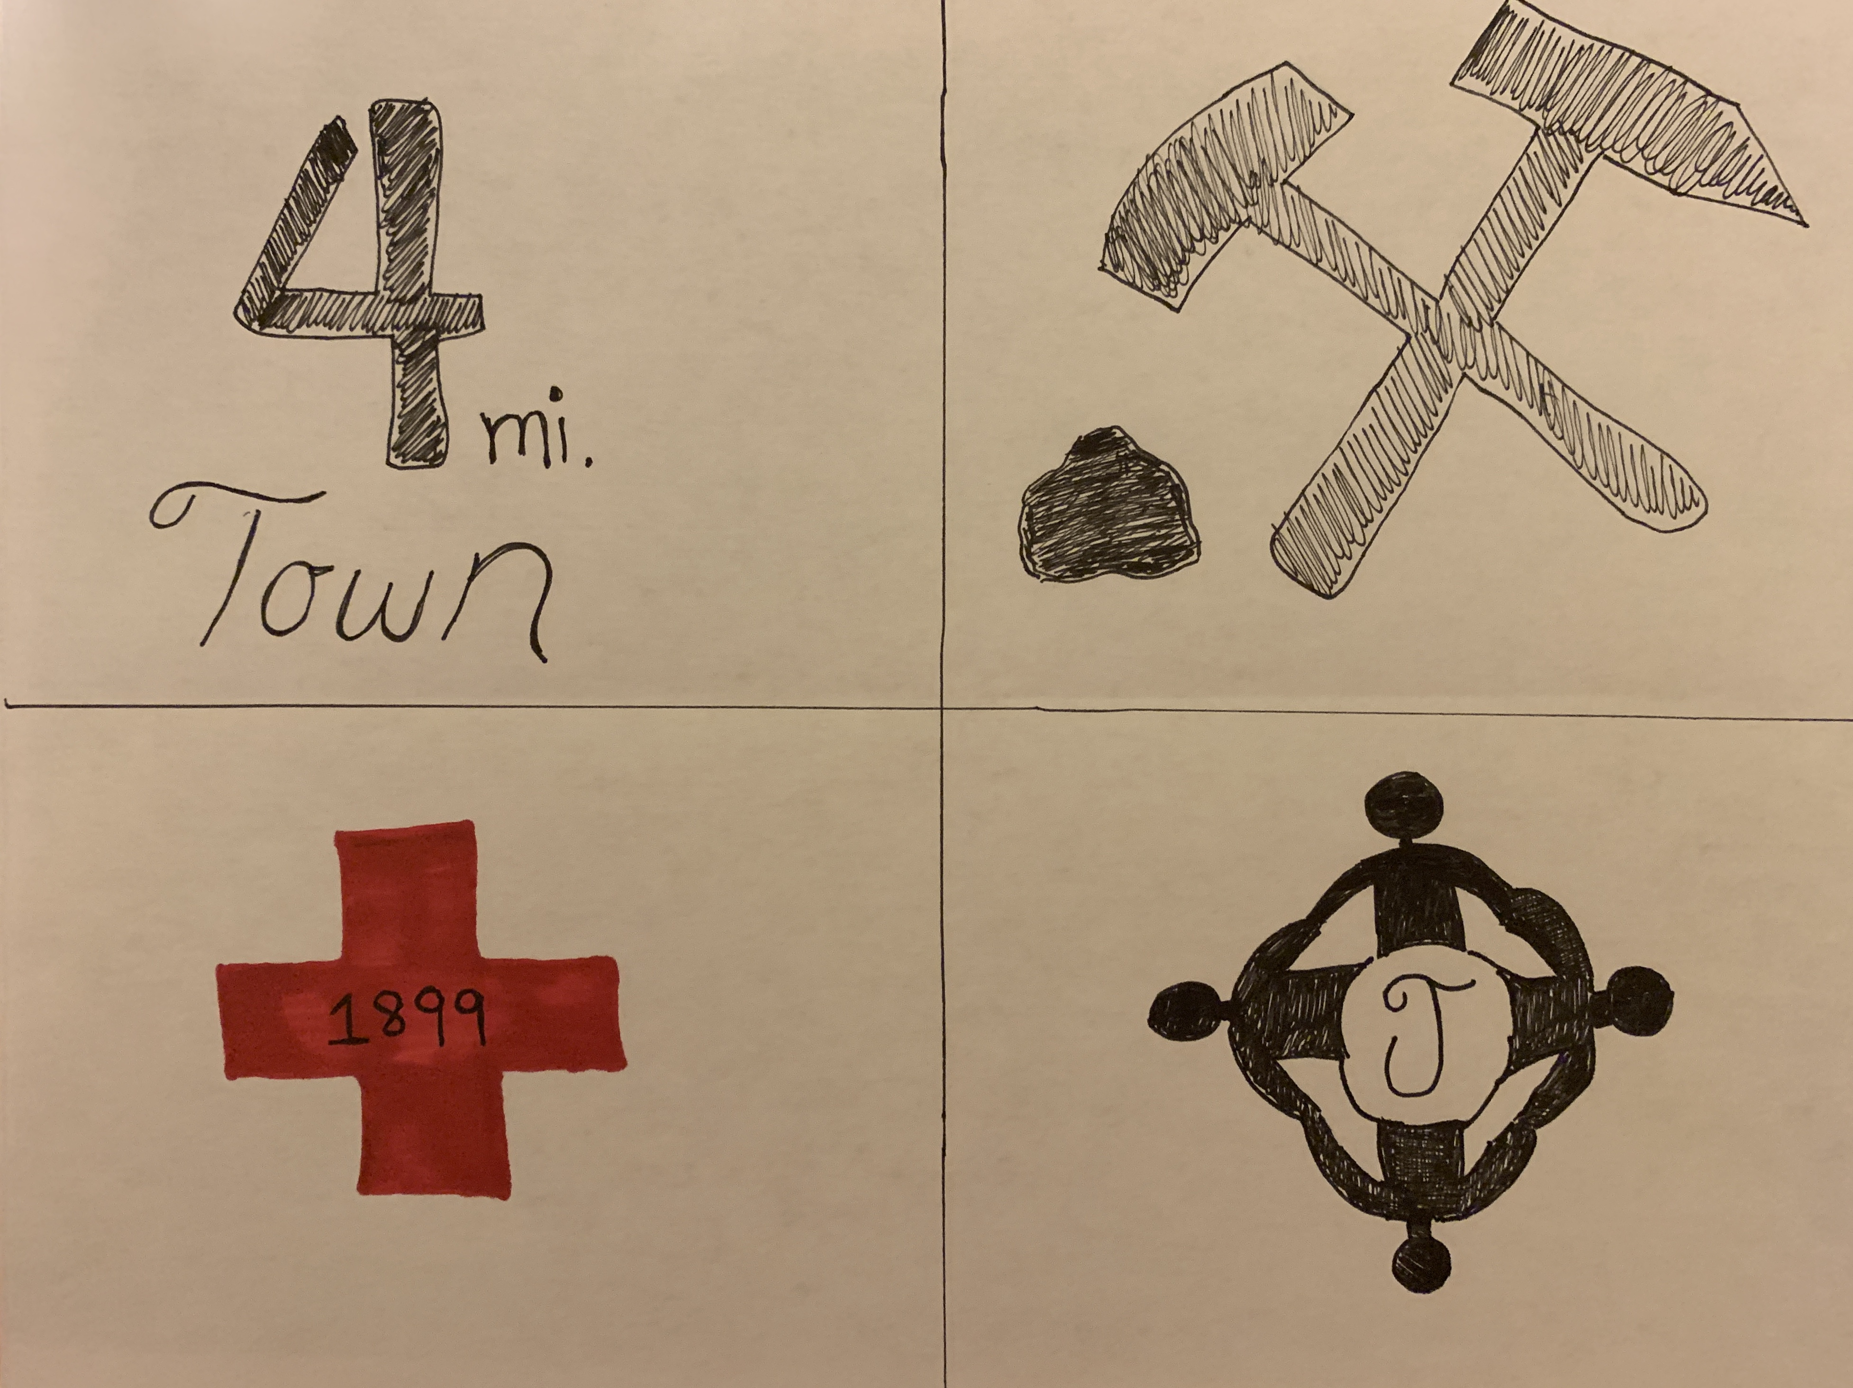
Brittany Mercadante
Forty Fort, PA submission

Slide 9

jimibear57@aol.com submission 1

Slide 10

jimibear57@aol.com submission 2

Slide 11

Amy ryczak submission 1

Slide 12

Amy ryczak submission 2

Slide 13
Amy ryczak submission 3

Slide 14
Amy ryczak submission 4

Slide 15
Amy ryczak submission 5

Slide 16
Amy ryczak submission 6

Slide 17
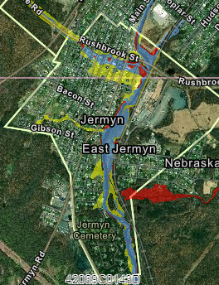
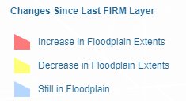
Lackawanna County Flood Maps
Effective 8/5/20
https://www.lackawannacounty.org/index.php/lackawanna-county-flood-risk-coalition

Slide 18
